Slide 1
Motion Features for Action Recognition
YeHao
3/11/2014

Slide 2
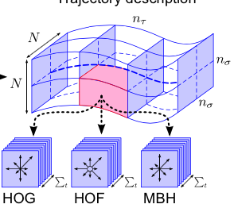
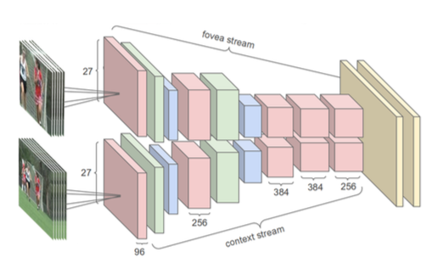
Motion Information
Dense Trajectory
DNN

Slide 3
Trajectory
Tracking Interest Points
Tracking Harris3D Interest point
KLT Tracker: Sparse Interest Points.
Matching SIFT descriptor
Computationally Expensive

Slide 4
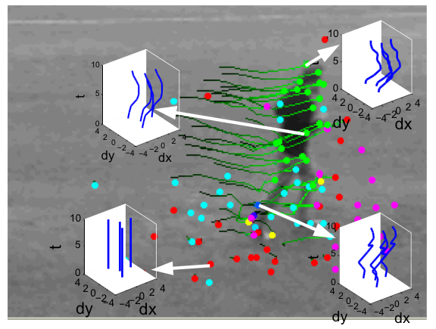
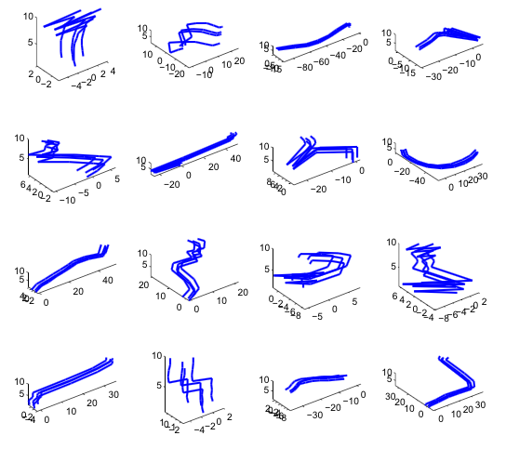

Slide 5
KLT Tracker
1. Three Assumptions:
Intensity
Velocity
Space
Notes:
亮度恒定：保证等号成立
时间连续或者运动是小运动： 保证KLT能够找到点
空间一致，临近点有相似运动，保持相邻： 保证对一个窗口，所有的偏移量都相等

Slide 6
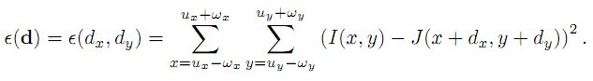
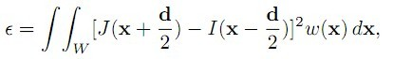
Derivation of KLT Tracker
Notes:
1）在窗口w上，所有(x, y)都往一个方向移动了(dx, dy)，从而得到(x', y')，即t时刻的(x, y)点在t+τ时刻为(x+dx, y+dy)，所以寻求匹配的问题可化为对以下的式子寻求最小值
2）这个式子的含义，即找到两副图像中，在W窗口中，I、J的差异，其中I以x-d/2为中心，J以x+d/2为中心，w/2为半径的一个矩形窗口间的差异，好吧，结合我们微积分的知识，函数ε(d)要取得最小值，这个极值点的导数一定为0

Slide 7
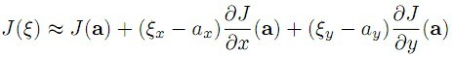
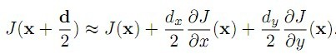
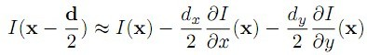
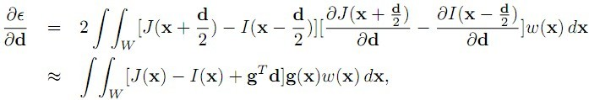
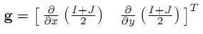
Derivation of KLT Tracker (II)

Slide 8
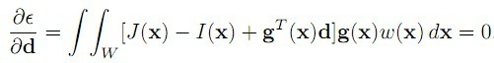
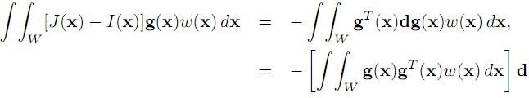
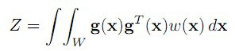
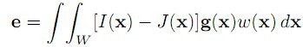
Derivation of KLT Tracker (III)
Notes:
为了要使d能够得到解，则Z需要满足条件，即Z*Z'矩阵可逆，其中Z'为Z矩阵的转置(ZT)，在一般情况下，角点具有这样的特点。

Slide 9
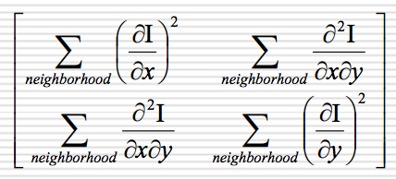
Good Features to Track
Intuitively, a good feature needs at least:
Texture
Corner
But what does this mean formally?
Shi/Tomasi. Intuitive result really part of motion equation.
High eigenvalues imply reliable solvability.
Good Feature has big eigenvalues, imply:
Texture
Corner
Notes:
2个小eig val： 没有纹理信息
1个大， 1个小： 单向
2个大，2个方向，纹理信息强

Slide 10
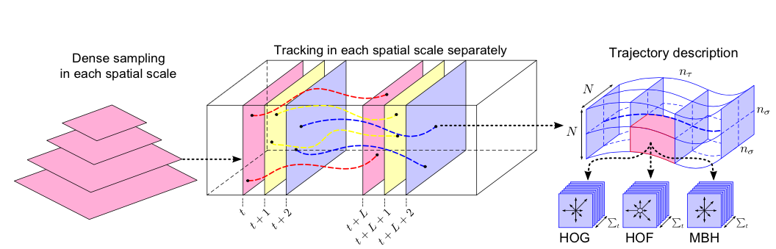
Dense Trajectory
Notes:
M: 中值滤波
W: optical flow field

Slide 11
Dense Trajectory
Optical Flow: OpenCV
Drifting: Limit to L frames
Sudden large displacement: Remove

Slide 12
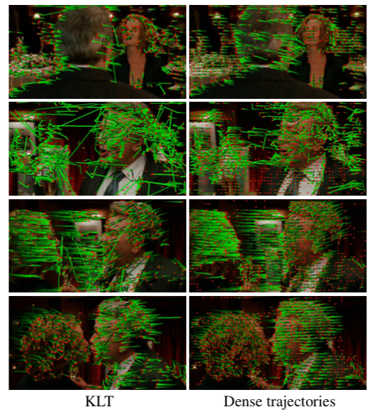
Dense Trajectory

Slide 13
Trajectory-aligned Descriptors
Histograms of Oriented Gradients (HOG)
Appearance Information
Histograms of Optical Flow (HOF)
Local motion information
Motion Boundary Histogram (MBH)
Relative motion between pixels

Slide 14
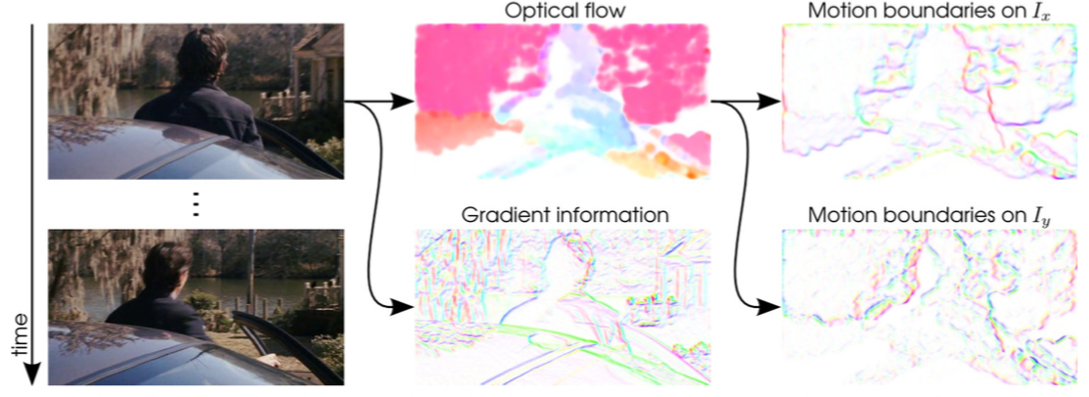
Camera Motion
Notes:
光流信息计算了绝对的运动信息，不可避免引入镜头移动信息。
对比MBH 计算了光流的梯度信息。
对比光流信息，Motion boundaries 压制了背景镜头移动，突出了前景

Slide 15
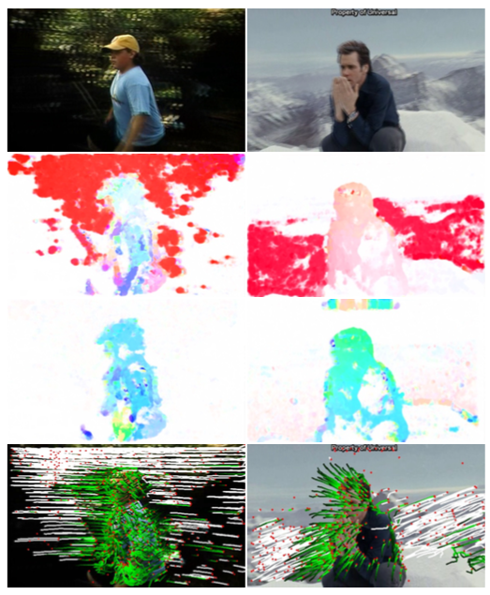
Improved Trajectory
Notes:
第一行： 2幅原图
第二行：光流
第三行： 去除镜头移动后的光流
第四行：白色的点为去除的轨迹

Slide 16
Improved Trajectory
Camera Motion Estimation
Two consecutive frames are related by a homography
Match SURF feature
Match optical flow vector
Estimate homography by RANSAC

Slide 17
Homography Conditions
Both images are viewing the same plane from a different angle
Both images are taken from the same camera but from a different angle
Homography relationship is independent of the scene structure
It does not depend on what the cameras are looking at
Relationship holds regardless of what is seen in the images

Slide 18
Homography
The homography relates the pixel co-ordinates in two images if x’ = M x
When applied to every pixel the new image is a warped version of the original image

Slide 19
Homography
Consider a point x = (u,v,1) in one image and x’=(u’,v’,1) in another image
A homography is a 3 by 3 matrix M

Slide 20
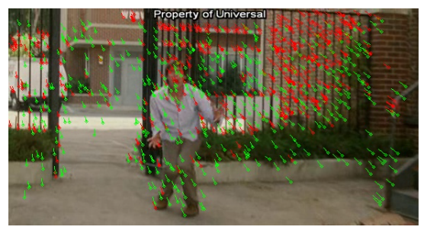
Notes:
Green : SURF descriptor matches
Red: dense optical flow

Slide 21
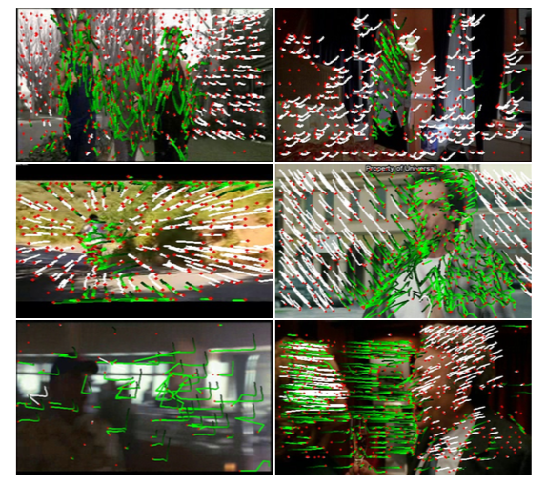
Notes:
pan, zoom, tilt.
The last row shows two failure cases.
The left one is due to severe motion blur.
The right one fits the homography to the moving humans as they dominate the frame.

Slide 22
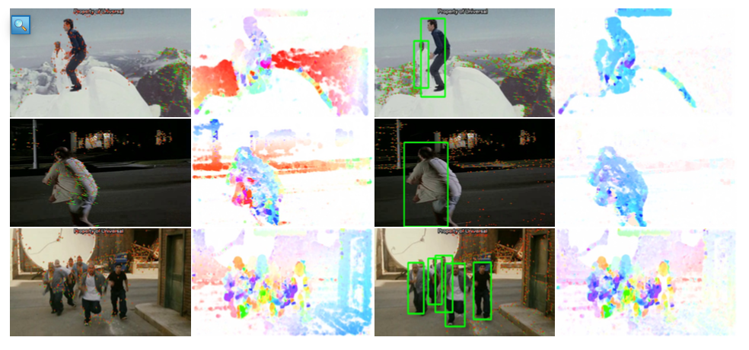
Removing inconsistent matches due to humans
Notes:
Row 4: the background is represented by two planes

Slide 23
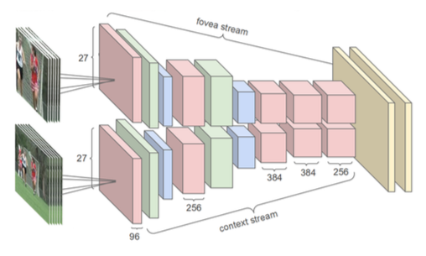
Video Classification with Convolutional Neural Networks

Slide 24
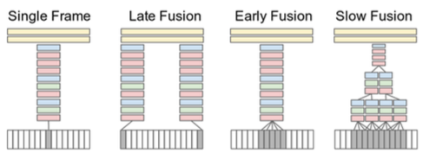

Slide 25
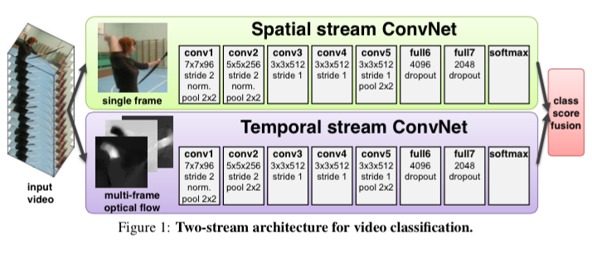
Two-Stream Convolutional Networks

Slide 26
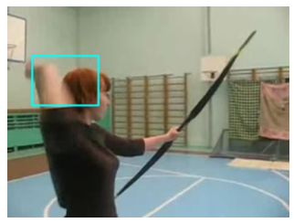
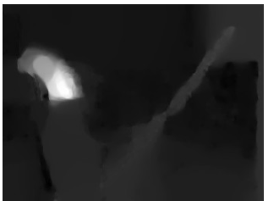
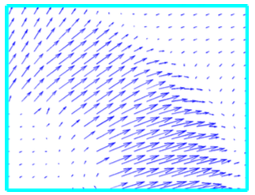
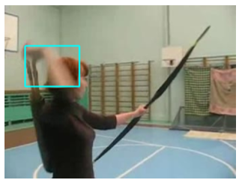
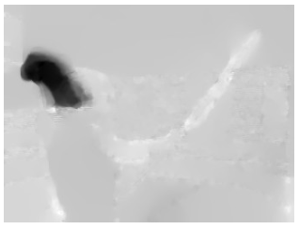
Optical Flow

Slide 27
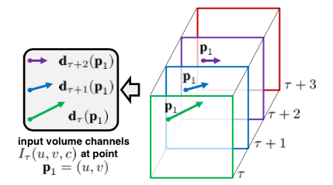
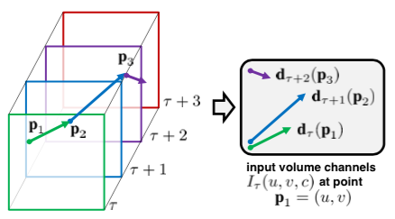
Stacking
Optical Flow
Trajectory

Slide 28
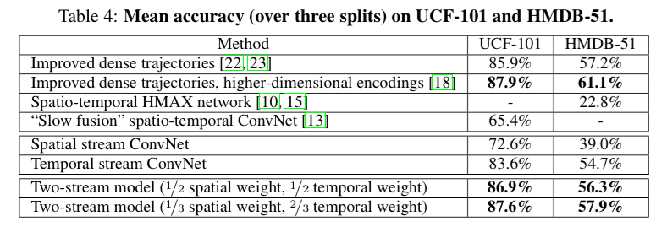
Accuracy

Slide 29
Reference
[1] H. Wang, “Evaluation of local spatio-temporal features for action recognition,” presented at the CRV '12: Proceedings of the 2012 Ninth Conference on Computer and Robot Vision, 2012, pp. 468–475.
[2] H. Wang, A. Klaser, C. Schmid, and C.-L. Liu, “Action recognition by dense trajectories,” presented at the Computer Vision and Pattern Recognition (CVPR), 2011 IEEE Conference on, 2011, pp. 3169–3176.
[3] A. Karpathy, G. Toderici, and S. Shetty, “Large-scale video classification with convolutional neural networks,” … on Computer Vision …, 2014.
[4] K. Simonyan and A. Zisserman, “Two-Stream Convolutional Networks for Action Recognition in Videos,” arXiv.org, vol. cs.CV. 09-Jun-2014.

